Slide 1
Networks Fundamentals
Mousa Al-Sahory

Slide 2
Chapter 2
Network Fundamentals
Network Devices
2

Slide 3
Network Devices
Network Components or network infrastructure contains three categories of hardware components:
End devices
Intermediate devices
Network media

Slide 4
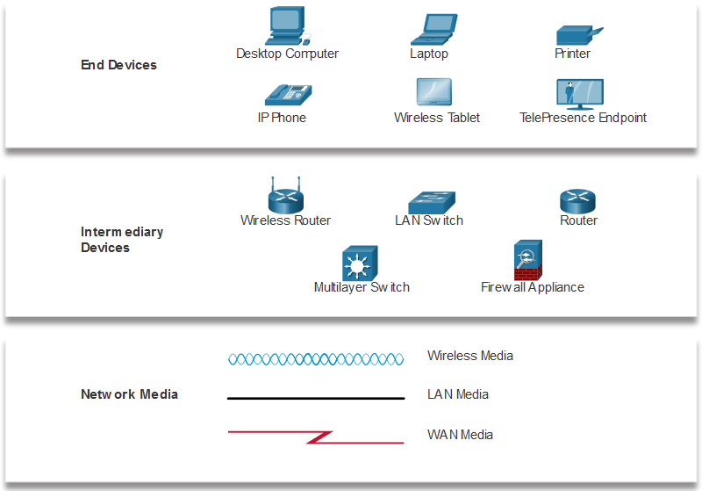
Network Devices
4

Slide 5
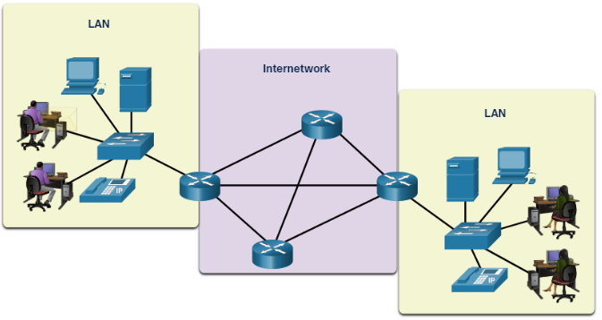
End Devices
The network devices that people are most familiar with are called end devices, or hosts. These devices form the interface between users and the underlying communication network.
Some examples of end devices are as follows:
Computers (workstations, laptops, file servers, web servers)
Network printers
Telephones and teleconferencing equipment
Security cameras
Mobile devices (such as smart phones, tablets, PDAs, and wireless debit/credit card readers and barcode scanners)

Slide 6
Network Devices – Hub
The hub is a simple device that transmits an incoming frame out all the other ports on the hub.
Connects a group of hosts (Multiple ports)
Works at Layer 1 (Physical layer)
Half-Duplex : connection transmits data in both directions but in only one direction at a time
Amplifier
Resends the data
The hub is a (multi-port repeater).

Slide 7
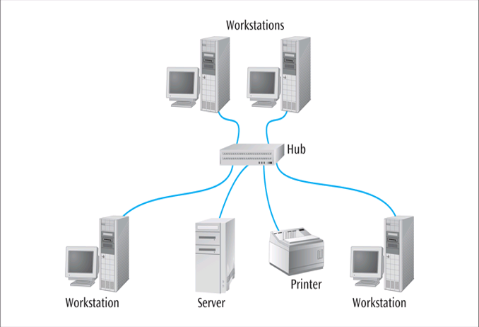
Network Devices – Hub
All devices are in the same collision domain.
All devices are in the same broadcast domain.
Devices share the same bandwidth.
More end stations means more collisions.
Biggest disadvantage: when one station talks, everyone hears it

Slide 8
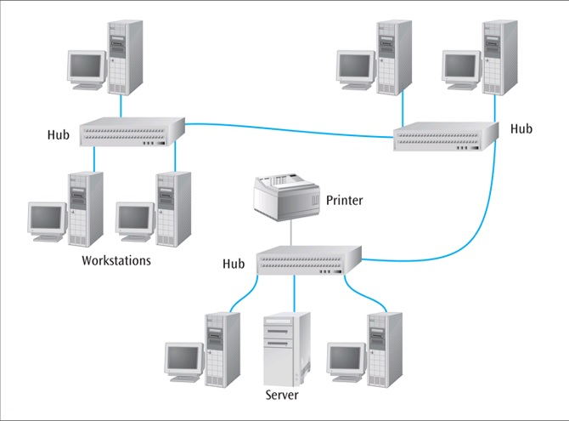
Network Devices – Hub

Slide 9
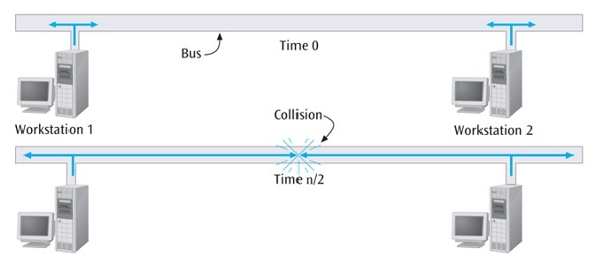
Network Collision
If two workstations transmit at same time, collision occurs

Slide 10
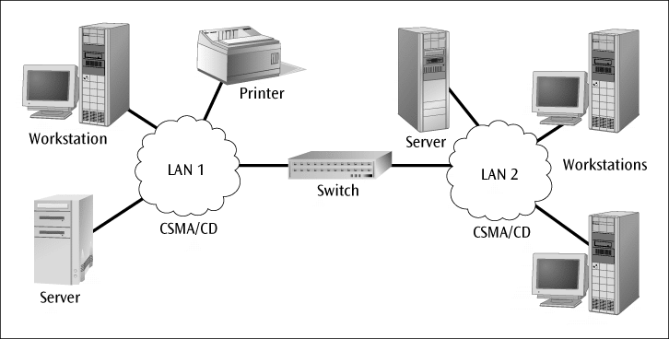
Network Devices – Switch
The switch has intelligence and can filter out and forward frames based on their NIC address.
A switch maintains internal port table(s) that keep track of which frames arrived on which ports.
A switch observes each frame that arrives at a port, extracts the source address from the frame, and places that address in the port’s routing table.

Slide 11
Network Devices – Switch
Amplifier
Resends the data
Multiple ports
Full duplex : connection transmits data in both directions and at the same time
helps to eliminate collisions.
Works at Layer 2 (Data Link
layer).

Slide 12
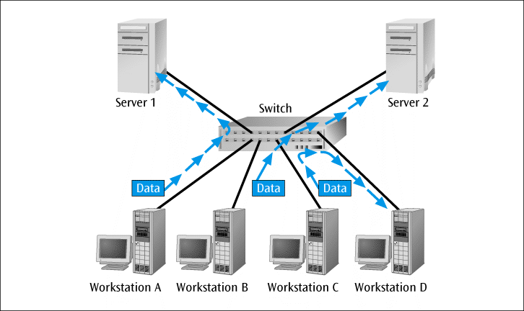
Network Devices – Switch
Switch functions at layer 2:
Address learning: the switch learns the source MAC address of each frame received on an interface and enter it into a table called forward/filter table.
Forward/filter decisions: the switch looks at the destination MAC address for the frame received on an interface and finds the exit interface on the forward/filter table.
Switches are used to connect end devices to a single LAN
Switches can segment collision domains and provide enhanced security

Slide 13
Network Devices – Switch

Slide 14
Network Devices – Router
Works at Layer 3 (Network layer).
Logical addressing
Full duplex
Routers are primarily devices used to interconnect networks – LANs, WANs, and WLANs.
Route packets of data from one network to another → Path determination
Routers, by default, break up a broadcast domain → Broadcast control
Multicast control

Slide 15
Network Devices – Router
Router is connected to two or more data lines from different networks (it has interfaces for different physical types of network connections (copper, fiber, wireless)
Router checks the packet looking at the destination ip address
It makes the decision based on the routing table
Routing tables are populated with static and dynamic entries
Routers exchange information about destination addresses using dynamic routing protocols

Slide 16
Network Devices – Router
Router Interfaces
Data Interfaces:
Serial interface (WAN Interface) connects to another router.
Ethernet interface (LAN Interface) connects to a switch, bridge, hub, repeater.

Slide 17
Network Devices – WLC / AP
Access-points
can be considered as wireless bridges/switches
They allow mobile users to connect to the network
Two types: Autonomous and Lightweight APs
Wireless LAN controller (WLC)
The AP communicates using a special protocol called the Lightweight AP Protocol (LWAPP) to relay information to the WLC.
LWAPP is encrypted

Slide 18
Network Devices – Security Appliances
A firewall is a system or group of systems that manages access between two or more networks.
Controls incoming and outgoing traffic by analyzing the data packets.
Software or Hardware
Firewall allows or drops the traffic according to the configured rules
Can filter the traffic from Layer 3 up to 7

Slide 19
Network Devices – Security Appliances
IPS/IDS can prevent from known network attacks and worms, reconnaissance, spyware, Trojans, backdoors, bots – detection based on the signatures
Intrusion Detection Systems (IDS): analyze and monitor network traffic for signs that indicate attackers are using a known cyberthreat to infiltrate or steal data from your network(Just alarm).
Intrusion Prevention Systems (IPS): analyze and monitor network traffic as a firewall, between the outside world and the internal network.(take action)

Slide 20
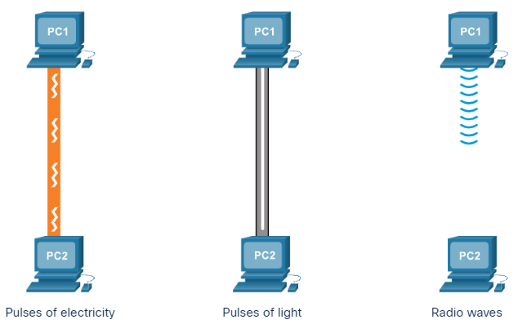
Data Transmission
There are three common methods of signal transmission used in networks:
Electrical signals : Transmission is achieved by representing data as electrical pulses
Optical signals :Transmission is achieved by converting the electrical signals into light pulses.
Wireless signals : Transmission is achieved by using infrared, microwave, or radio waves through the air.

Slide 21
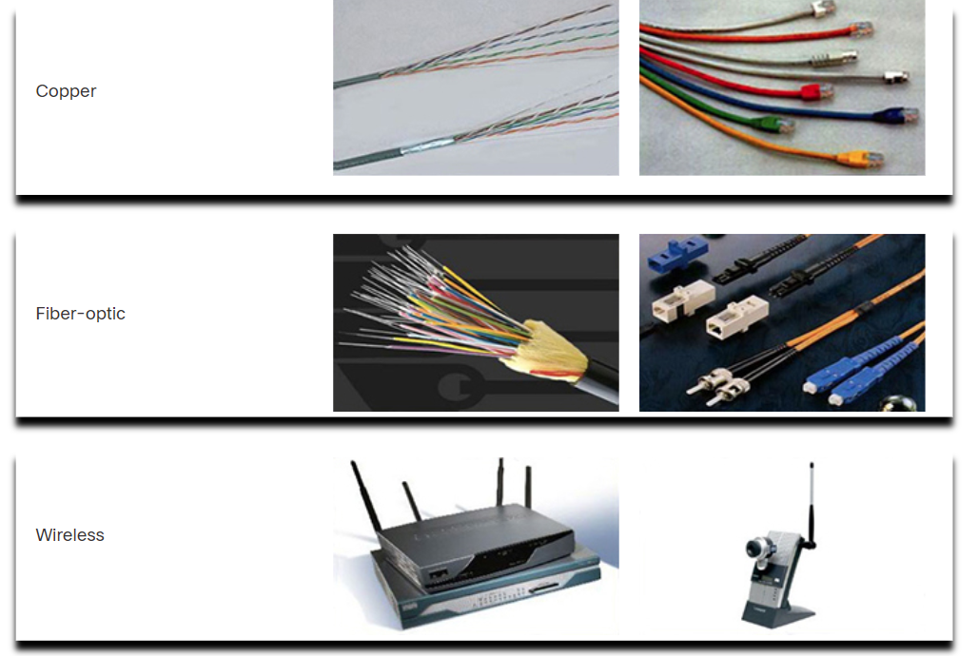
Network Media Types
Communication transmits across a network on media.
Modern networks primarily use three types of media to interconnect devices.
Metal wires within cables - Data is encoded into electrical impulses.
Glass or plastic fibers within cables (fiber-optic cable) - Data is encoded into pulses of light.
Wireless transmission - Data is encoded via modulation of specific frequencies of electromagnetic waves.

Slide 22
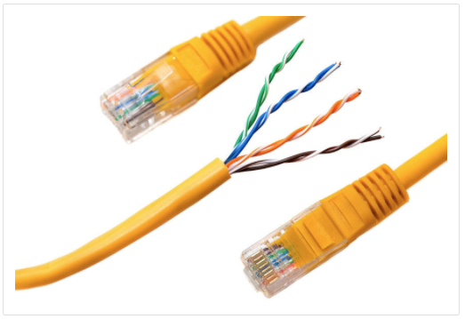
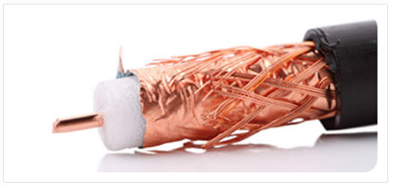
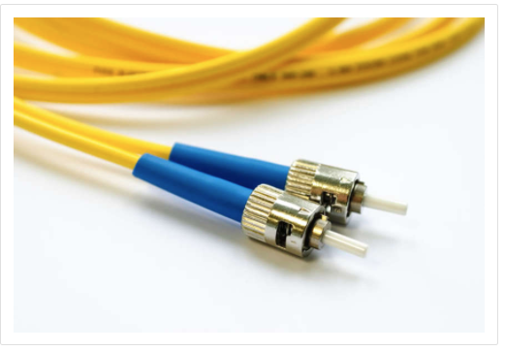
Network Media Types
The three most common network cables are twisted-pair cable, coaxial cable, and fiber-optic cable.
Twisted-Pair Cable
Coaxial Cable
Fiber-Optic Cable

Slide 23
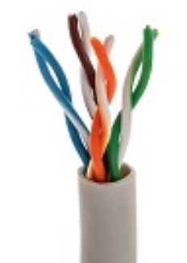
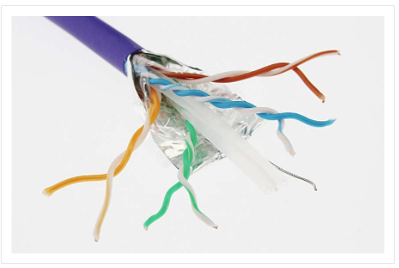
Twisted-Pair Cables
Ethernet technology generally uses twisted-pair cables to interconnect devices.
The networks in most homes and schools are wired with twisted-pair copper cable.
Most common form of wire
This type of cable is inexpensive and readily available.
Twisted-pair cable uses pulses of electricity to transmit data.
There are two commonly installed types of twisted-pair cable:
Unshielded twisted-pair (UTP)
Shielded cables (STP)

Slide 24
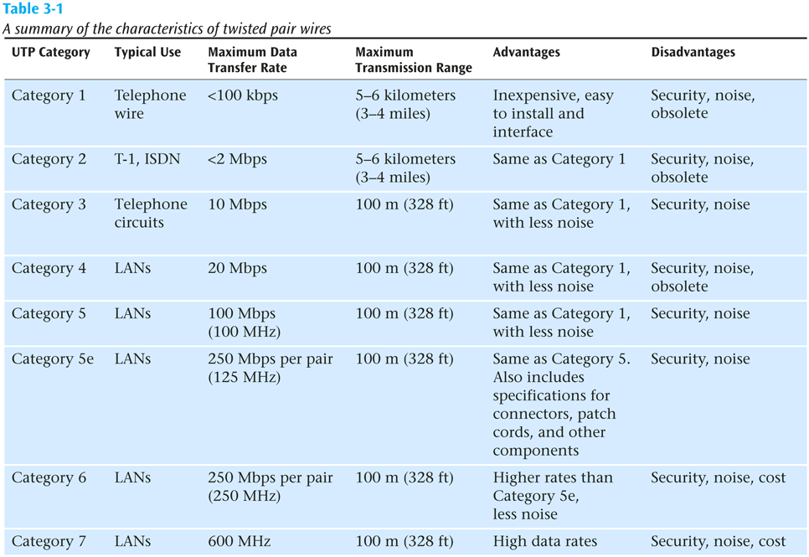
Twisted-Pair Cables

Slide 25
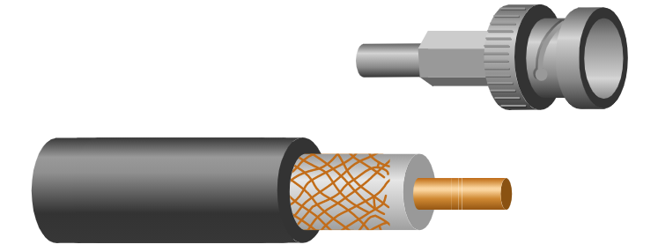
Coaxial Cable
A single wire wrapped in a foam insulation surrounded by a braided metal shield, then covered in a plastic jacket. Cable comes in various thicknesses.
Cable TV and Satellite Cables
It was one of the earliest network cabling types developed.
Coaxial cable (or coax) carries data in the form of electrical signals.
It provides improved shielding compared to UTP and can therefore carry more data.

Slide 26
Coaxial Cable
It is used by cable television companies to provide service and for connecting the various components that make up satellite communication systems.
It is used as a high-frequency transmission line to carry high-frequency or broadband signals.
More expensive than twisted pair

Slide 27
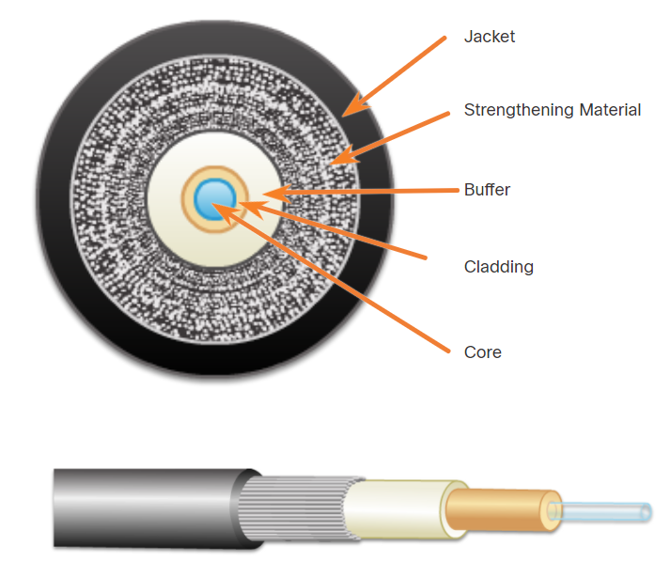
Fiber-Optic Cables
A thin glass cable approximately a little thicker than a human hair surrounded by a plastic coating and packaged into an insulated cable.
Fiber optic cable can carry the highest data rate for the longest distances but more expensive.
Fiber-optic cables transmit data using pulses of light.
Fiber-optic cable is constructed of either glass or plastic.

Slide 28
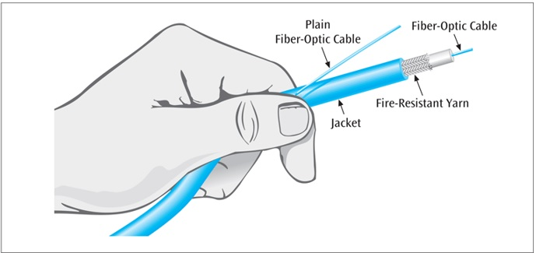
Fiber-Optic Cables
Parts of a fiber-optical cable are:
Jacket - protects the fiber against abrasion, moisture, and other contaminants.
Strengthening Material - Surrounds the buffer, prevents the fiber cable from being stretched when it is being pulled
Buffer - Used to help shield the core and cladding from damage.
Cladding - Made from slightly different chemicals than those used to create the core. It tends to act like a mirror.
Core - The light transmission element at the center of the optical fiber. Light pulses travel through the fiber core.

Slide 29
Fiber-Optic Cables
Fiber-optic cable is capable of supporting millions of bits per second for 1000s of meters.
Thick cable (62.5/125 microns) causes more ray collisions, so you have to transmit slower. This is step index multimode fiber. Typically use LED for light source, shorter distance transmissions.
Thin cable (8.3/125 microns) – very little reflection, fast transmission, typically uses a laser, longer transmission distances; known as single mode fiber.

Slide 30
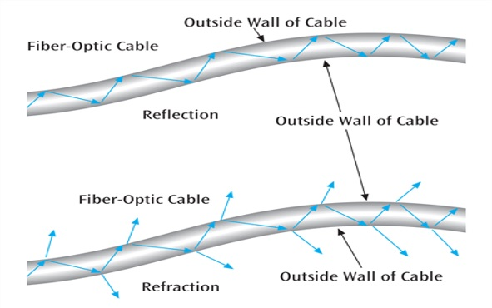
Fiber-Optic Cables
Fiber-optic cable is susceptible to :
Reflection (where the light source bounces around inside the cable)
Refraction (where the light source passes out of the core and into the surrounding cladding)

Slide 31
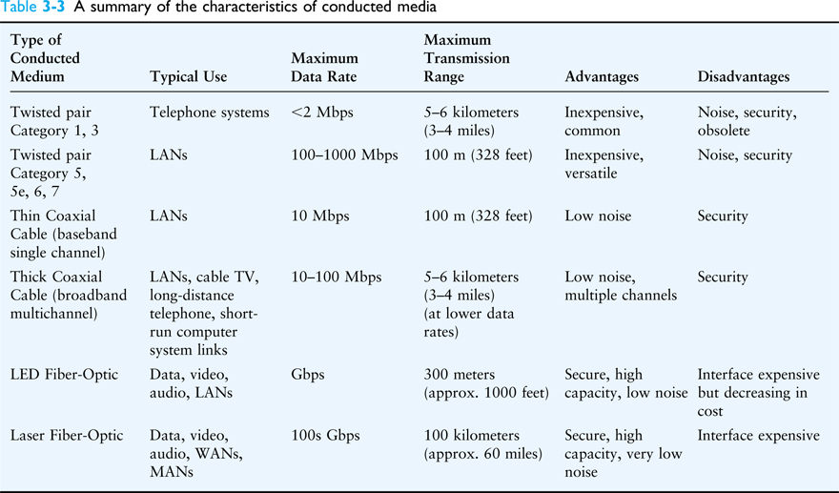
Network Cables

Slide 32
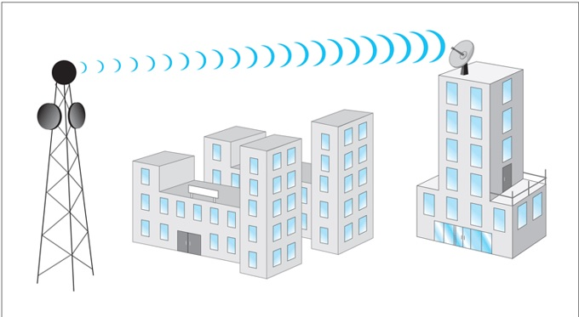
Wireless Media
Radio, satellite transmissions, and infrared light are all different forms of electromagnetic waves that are used to transmit data.
Terrestrial Microwave Transmission
Land-based,line-of-sight transmission
Approximately 20-30 miles between towers
Transmits data at hundreds of millions of bits per second
Signals will not pass through solid objects
Popular with telephone companies and business to business transmissions

Slide 33
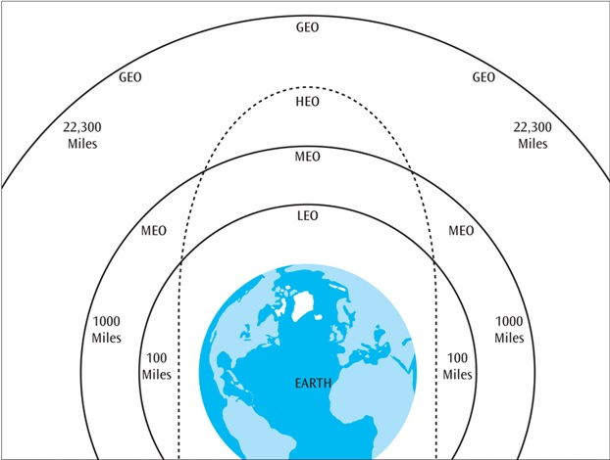
Wireless Media
Satellite Microwave Transmission
Similar to terrestrial microwave except the signal travels from a ground station on earth to a satellite and back to another ground station.
Can also transmit signals from one satellite to another.
Satellites can be classified by how far out into orbit each one is (LEO, MEO, GEO, and HEO)

Slide 34
Wireless Media
LEO (Low-Earth-Orbit) – 100 to 1000 miles out
Used for wireless e-mail, special mobile telephones, pagers, spying, videoconferencing
MEO (Middle-Earth-Orbit) – 1000 to 22,300 miles
Used for GPS (global positioning systems) and government
GEO (Geosynchronous-Earth-Orbit) – 22,300 miles
Always over the same position on earth (and always over the equator)
Used for weather, television, government operations
HEO (Highly Elliptical Earth orbit) – satellite follows an elliptical orbit
Used by the military for spying and by scientific organizations for photographing celestial bodies

Slide 35
Q&A

